Slide 1

SIR SYED UNIVERSITY OF ENGINEERING AND TECHNOLOGY

Slide 2
COURSE: DESIGN ANALYSIS AND ALGORITHM (CS-327)
COURSE INSTRUCTOR: MISS AIMAN
PRESENTED BY : ZAINAB ARIF ROLL NUMBER: 2023s-BCYS-028 SEMESTER: 4th PROGRAM: BS-CYBER SECURITY DEPARTMENT: SOFTWARE ENGINEERING

Slide 3
PRESENTATION TOPIC: RABIN-KARP ALGORITHM
String Matching Technique

Slide 4
What is Rabin-Karp?
The Rabin-Karp Algorithm is a string-matching algorithm used to find a specific substring pattern or word in a larger piece of text. It’s particularly useful when you need to search for multiple patterns efficiently.
Key Idea: The algorithm uses hashing to compare the pattern with parts of the text, instead of comparing each character directly. (Hashing refers mapping a larger string input value to a smaller number output value called hash value)

Slide 5
Key Concepts
Pattern: The word or sequence you want to find (e.g., "abc").
Hashing: Converts a string (e.g., "abc") into a number (e.g, 5).
Sliding Window: Moves across the text, one piece at a time.
Rolling Hash: Allows you to update the hash value for a new substring by efficiently removing the contribution of the old character and adding the contribution of the new character. This makes it possible to slide the pattern over the text and calculate the hash value for each substring without recalculating the entire hash from scratch.

Slide 6
How Rabin-Karp Algorithm Works?
A sequence of characters text is taken and checked for the possibility of the presence of the required pattern. If the possibility is found then, character matching is performed.
Let us understand the algorithm with the following Problem Statement: Let the text be: DAACABCDBA
And the string to be searched in the above text be: CAB

Slide 7
Let us assign a numerical value(v)/weight for the characters we will be using in the problem.
1
2
3
4
5
6
7
8
9
10
D
A
A
C
A
B
C
D
B
A
Base = 10

Slide 8
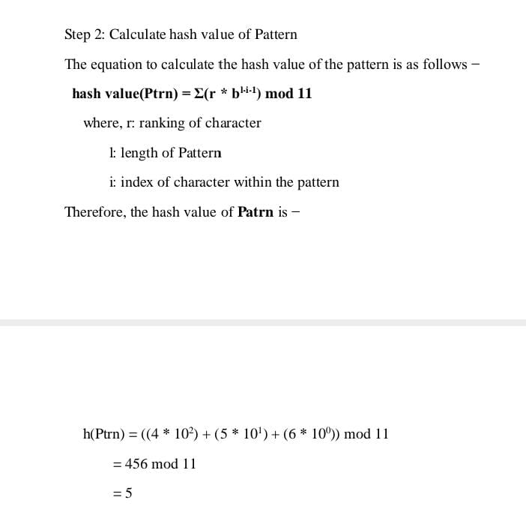
Hash Value Calculation Formula
The hash value of a string is calculated using:
h(String) = Σ(r * b^(l-i-1)) mod m
Where:
• r = rank of the character
• l = length of the string
• b = base value (10)
• m = modulo (11)
Here take modulus m =11 for our hash function In the calculation, we use a modulus value to find the hash. The modulus should be a prime number because prime numbers help reduce hash collisions and ensure better remainder/answer, avoiding overflow issues. A smaller modulus like 7,9,11, or 13 can work if the text size and character set are small. Larger primes like 17,19,or 31 can be used for better hash distribution when working with a larger text or character set.

Slide 9
Step 1 - Calculate Hash Value of Pattern
For Pattern = CAB:
• C = 4, A = 5, B = 6
h(CAB) =(4 * 10^2 + 5 * 10^1 + 6 * 10^0)mod 11
h(CAB) = (400 + 50 + 6) mod 11 = 456 mod 11 = 5
Hash of pattern = 5
ROUGH WORK: Step-by-step calculation:
1. For C (i = 0): r = 4, b^{l-i-1} = 10^{3-0-1} = 10^2 = 100 = 4 X 100 = 400
2. For A (i = 1): r = 5, b^{l-i-1} = 10^{3-1-1}= 10^1 = 10, 5 X 10= 50
3. For B (i = 2): r = 6, b^{l-i-1} = 10^{3-2-1}= 10^0 = 1, = 6 X 1= 6

Slide 10
Step 2 - Hash Value of First Window
For Window 1 = DAA:
• D = 1, A = 2, A = 3
h(DAA) = (1 * 10^2 + 2 * 10^1 + 3 * 10^0) mod 11
h(DAA) = (100 + 20 + 3) mod 11 = 123 mod 11 = 2
Hash of first window = 2 Now, compare the hash value of pattern and the substring. Compare: h(DAA) = 2 ≠ h(CAB) = 5.
If they match, check whether characters are matching or not. If they do, we found our match otherwise, move to the next characters. In the above example, hash value did not matched. Hence, we move to the next character.

Slide 11
Step 3 - Sliding Window Formula
In order to optimize this process, we make use of the previous hash value in the following way. We calculate the hash value of the next window by subtracting the first term and adding the next term. For subsequent windows, use:
h(new) = (b * (h(old) - r_outgoing * b^(l-1)) + r_incoming) mod m
Where:
• r_outgoing: rank of the outgoing character
• r_incoming: rank of the incoming character

Slide 12
Step 4 - Window Hash Calculations
h(new) = (b * (h(old) - r_outgoing * b^(l-1)) + r_incoming) mod m
1. Window 2: AAC
h(AAC) = (10 * (2 - 1 * 10^2) + 4) mod 11 = 3 Hash value did not matched. h(AAC) = 3 ≠ h(CAB) = 5. Hence, we move to the next character.
2. Window 3: ACA
h(ACA) = (10 * (3 - 2 * 10^2) + 5) mod 11 = 4 Hash value did not matched. h(ACA) = 4 ≠ h(CAB) = 5. Hence, we move to the next character.

Slide 13
3. Window 4: CAB
h(CAB) = (10 * (4 - 3 * 10^2) + 6) mod 11 = 5 (Hash Match!) . h(CAB) = 5 = h(CAB) = 5.
Now Check characters: CAB = CAB
Hence Pattern found at index 4!

Slide 14
If the pattern appears multiple times in the text, the Rabin-Karp algorithm will check every matching window where the hash value matches the pattern’s hash and characters… After finding the first match, the algorithm will continue searching through the text, checking for additional occurrences of the pattern.

Slide 15
Algorithm for Rabin-Karp Algorithm
Initialize Variables:
Assign numerical ranks to characters.
Define the base b and modulus m (prime number).
Compute b^(l-i-1) mod m where l is the length of the pattern.
Compute Initial Hash Values:
Calculate the hash value of the pattern h(pattern).
Calculate the hash value of the first window of text h(text-window).
Slide Through Text:
Compare h(pattern) with h(text-window):
If they match, verify character-by-character.
If verified, record the starting index of the match.
Update the hash value of the text window using the sliding formula: h(new) = (b * (h(old) - r_outgoing * b^(l-1)) + r_incoming) mod m
Continue Until End of Text:
Repeat step 3 for all windows in the text .
Output Matches:
Return the indices where the pattern was found.

Slide 16
Pseudocode for Rabin-Karp Algorithm
Function RabinKarp(Text, Pattern):
m = length of Pattern
n = length of Text
d = base value (e.g., 10)
q = prime number (e.g., 11) for modulus
hash_pattern = 0
hash_text_window = 0
h = (d^(m-1)) % q // Pre-compute the value of d^(m-1) % q

Slide 17
// Calculate hash value for Pattern
for i = 0 to m-1:
hash_pattern = (hash_pattern * d + value_of(Pattern[i])) % q
// Calculate hash value for the first window of Text
for i = 0 to m-1:
hash_text_window = (hash_text_window * d + value_of(Text[i])) % q
// Compare the hashes of Pattern and the first window of Text
if hash_pattern == hash_text_window:
if Text[0..m-1] == Pattern:
print "Pattern found at index 0"
// Sliding window: Iterate through the Text to compare every window
for i = 1 to n-m:
hash_text_window = (d * (hash_text_window - value_of(Text[i-1]) * h) + value_of(Text[i+m-1])) % q
if hash_pattern == hash_text_window:
if Text[i..i+m-1] == Pattern:
print "Pattern found at index " + i
End Function

Slide 18
Rabin-Karp Algorithm Time Complexity
m=length of pattern, n=length of text Best Case: O(m+n),occurs when there are no hash collisions, and the pattern is found quickly. Average Case: O(m+n), assumed to be the most common case, where the hash matches, but character comparisons are rare. Worst Case: O(mn),occurs when spurious hits occur a number for all the windows. Spurious hits mean when hash value of pattern match with hash value of window but the window is not the actual pattern.

Slide 19
Rabin-Karp Algorithm Space Complexity
We store only the hash value of the pattern and the current window of the text. This takes O(1) space.

Slide 20
Rabin-Karp Algorithm Advanatges
Efficient for multiple pattern searches.
Reduces unnecessary comparisons.

Slide 21
Why Use Rabin-Karp?
Plagiarism Detection: Compares large documents to detect copied or similar content by matching phrases or sentences.
Used in bioinformatics to identify specific DNA or protein patterns within larger genetic sequences.
Detects malicious patterns or signatures in network traffic/packets.
Efficiently finds substrings within large text files or databases. Example: Searching for "confidential" in a legal document.
Efficiently finds specific keywords or patterns within billions of web pages.
Detects spam emails by matching certain patterns, phrases, or keywords commonly associated with spam. Example: Filtering emails containing phrases like “Congratulations, you’ve won!” or “Free gift.”

Slide 22
Conclusion:
Rabin-Karp algorithm is an algorithm used for searching/matching patterns in the text using a hash function. Unlike Naive string matching algorithm, it does not travel through every character in the initial phase rather it filters the characters that do not match and then performs the comparison.

Slide 23
THANK YOU!

